Slide 1
Model Build Images

Slide 2
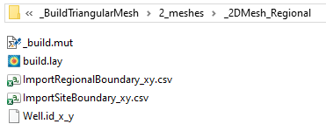
MESH_RegionalInitialFolderFiles.png
MUT input file
Tecplot layout file
Outer boundary
Inner boundary of refinement
Local points of refinement

Slide 3
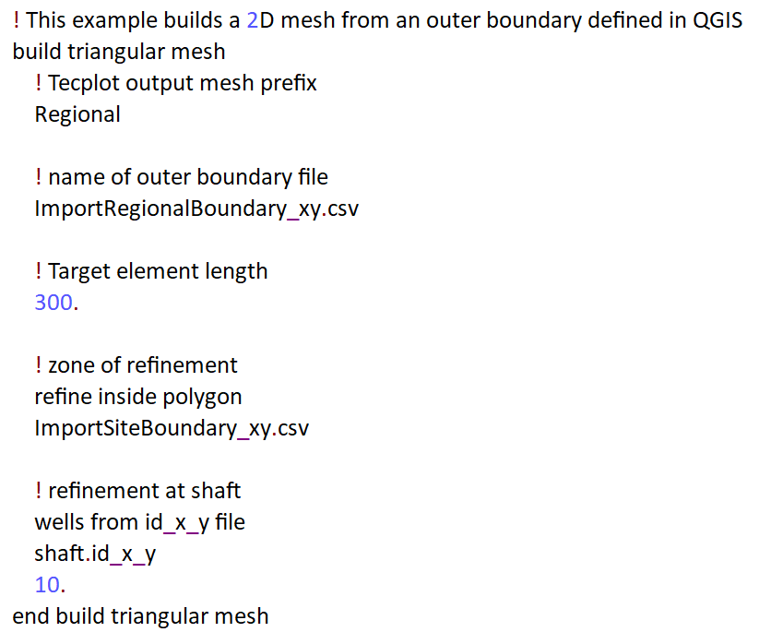
MUT_2DMeshInput.png
Comments begin with !
Mesh prefix
Regional boundary forms mesh outer boundary
Rough element size inside outer boundary will be 300 m
Refine the region inside the site boundary to roughly 150 m (half original target size)
Refine the cells containing node nearest the x,y location of the shaft to roughly 10 m

Slide 4
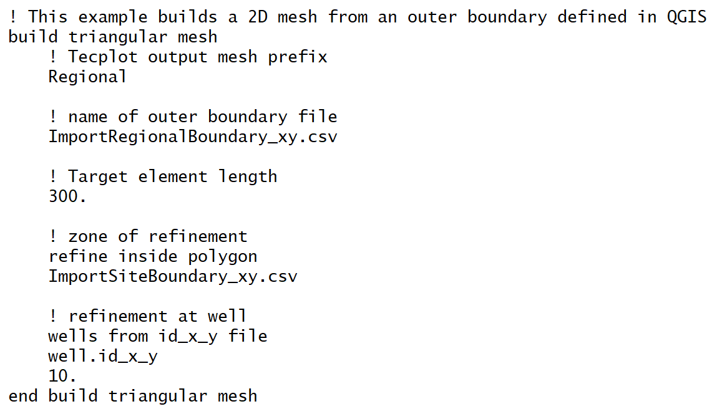
MUT_2DMeshInput.png
Comments begin with !
Mesh prefix
Regional boundary forms mesh outer boundary
Rough element size inside outer boundary will be 300 m
Refine the region inside the site boundary to roughly 150 m (half original target size)
Refine the cells containing node nearest the x,y location of the shaft to roughly 10 m

Slide 5
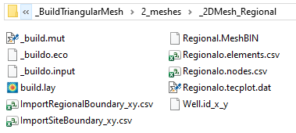
MESH_RegionalFinalFolderFiles.png
Binary Mesh file
Mesh element xyz coordinates
Mesh node xyz coordinates
Tecplot-formatted output file

Slide 6
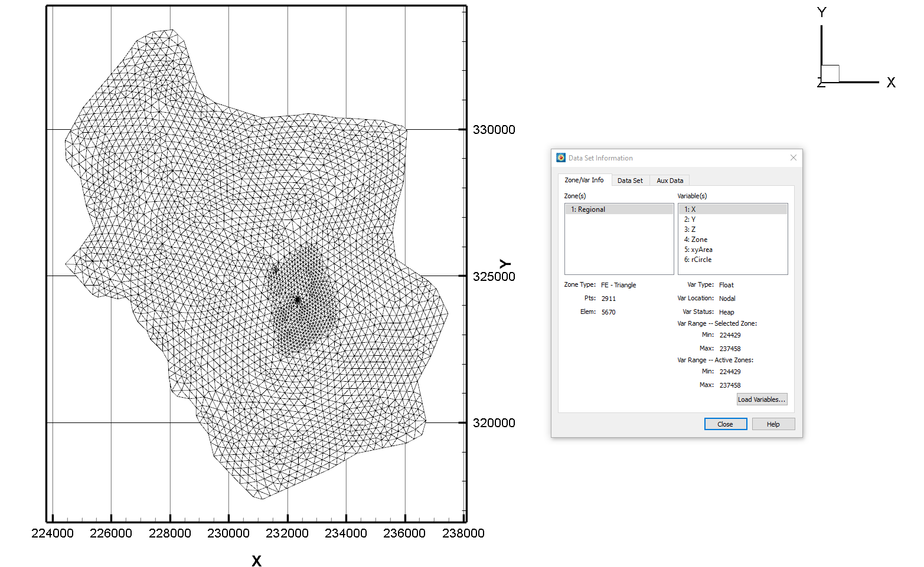
MUT_2DMeshInTecplot.png
Refined region inside the site boundary
Refined region at well
Number of nodes 2911
Number of Elements 5670

Slide 7
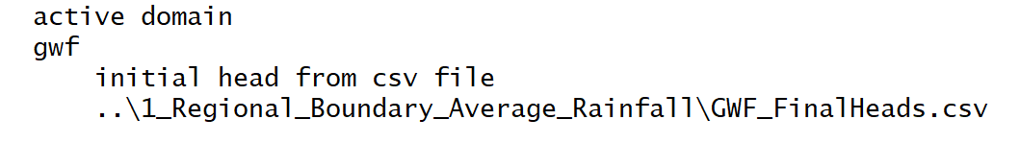
MUT_InitialGWFHead.png

Slide 8
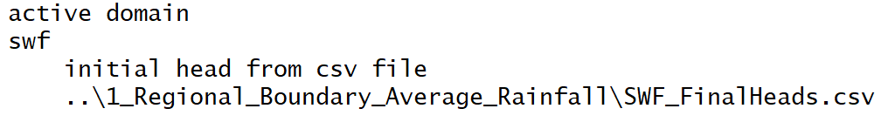
MUT_InitialSWFHead.png

Slide 9
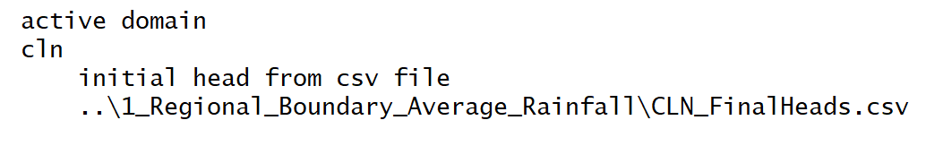
MUT_InitialCLNHead.png

Slide 10
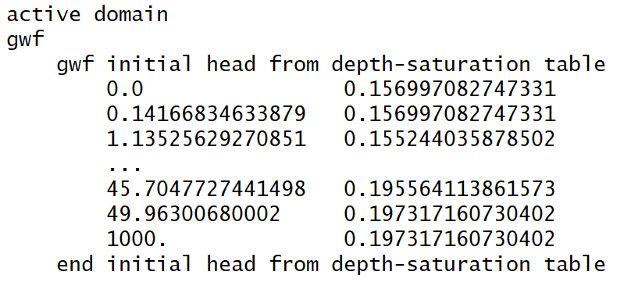
MUT_IheadDepthSat.png

Slide 11
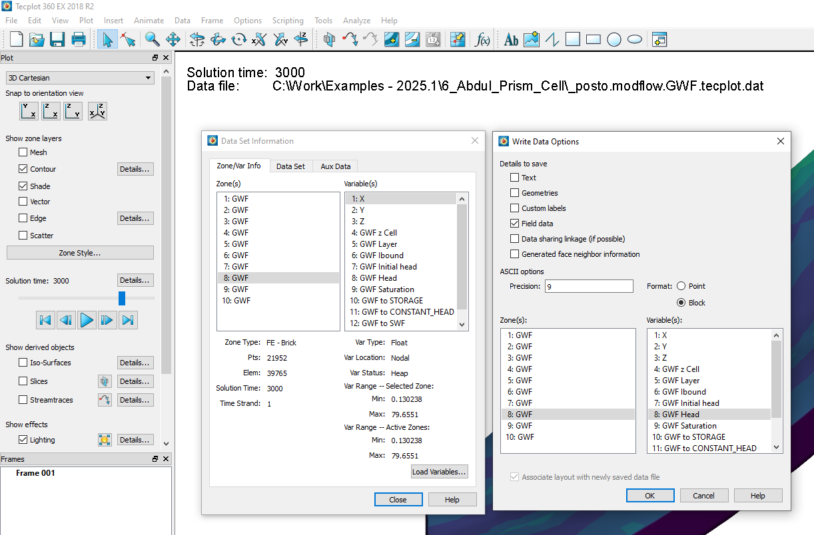
MUT_IHeadFromTecplot_1.png

Slide 12
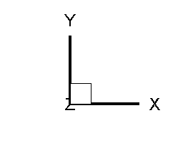

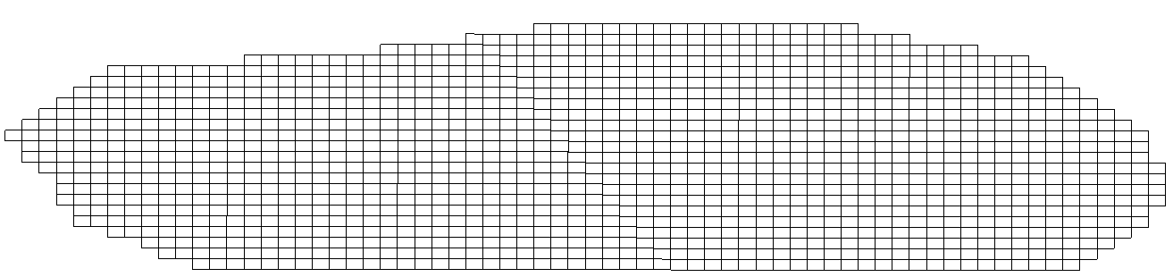
a)
b)
c)

